Slide 1

INFO6210 E-Commerce Database
Group 4
Ruobing Bai, Ruiwen Jin, Fred Sebastian, Jinning Yang, & Haozhou Zhou

Slide 2

Introduction
Management tool for online businesses
Redundancies
Purchase trends
Time-based demands
Further client's understanding
Inventory
Relationships – employee, suppliers, and customers
16 Entities divided into sales, management, and supplies

Slide 3

Business rules
Each Customer will have one or many Orders.
Each Order will have zero or many Returns.
Each Revenue will have zero or many Orders.
Each Order must have one Shipping Task.
Each Order must have one Order Detail.
Each Order Detail will have one or many Warehouse Peoducts.
Each Return must have one Warehouse Product.
Each Employee Salary Record will have zero or many Revenues.
Each Warehouse will have one or more Warehouse Products.
Each Employee will stay in one or many Warehouses.
Each Employee will have one or many Records of Employee Direct Deposit.
Each Employee will have zero or many Employee Reimbursements.
Each Employee will have one Employee Salary.
Each Employee will have zero or many Shipping Task.
Each Shipping Task will have one Shipping Record.
Each Warehouse Product will have one or many Products.
Each Product will have one or many Supplies Product Details.
Each Product will only be stored in one Warehouse. Supplies will have one or many Supplies Product Details. Supplies action date should be recorded in supplies action date.

Slide 4
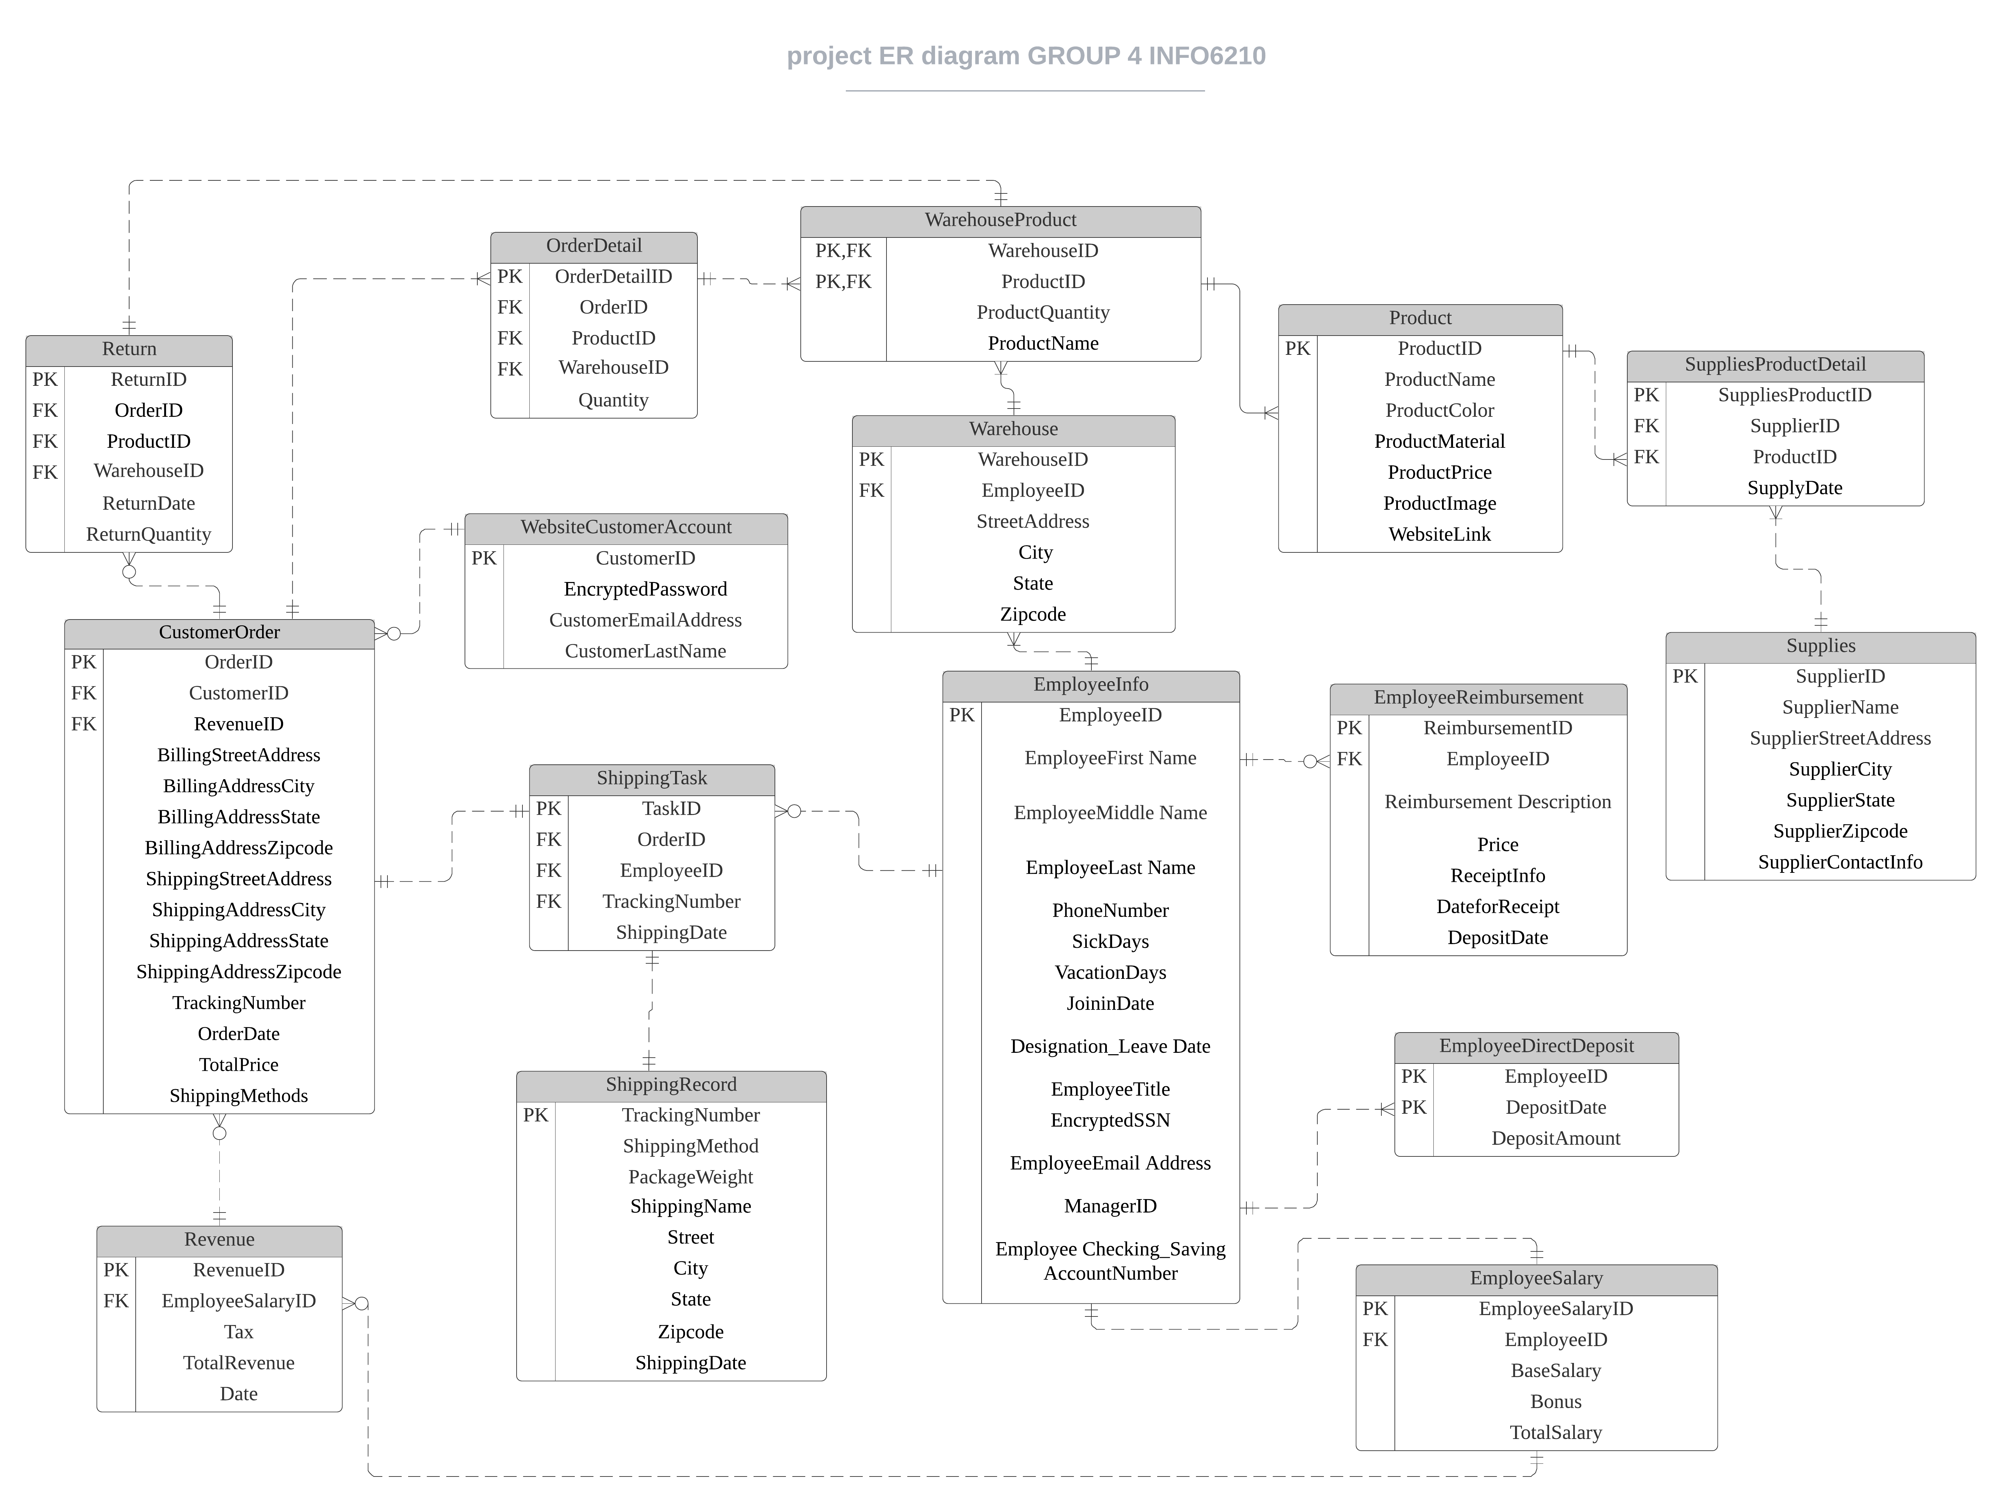
ERD Overview(3rd Norm)
16 Entities: | General class
WebsiteCustomerAccount | Sales
CustomerOrder
Return
Product
OrderDetail
ShippingTask
ShippingRecord
WarehouseProduct
Warehouse | Management
EmployeeInfo
EmployeeSalary
Revenue
EmployeeReimbursement
EmployeeDirectDeposit
SuppliesProductDetail | Supplies
Supplies

Slide 5

Entity and attributes design(ERD)

Slide 6
Data Implementation-table-level check constraints-Ruiwen
1. Salary range constraint on EmployeeSalary table for Salaryrange column, it is not permitted that one's salary be less than 1000 or greater than 100000.
ALTER TABLE Group4DB.dbo.EmployeeSalary ADD CONSTRAINT Salaryrange CHECK (TotalSalary>1000 AND TotalSalary<100000);
2. A ban policy for customers who return their products more than 5 times within a month.
CREATE FUNCTION num_return_1m(@cid int)
RETURNS int
AS
BEGIN
DECLARE @count int = 0;
SELECT @count = num
FROM(
SELECT TOP 1 COUNT(ReturnID) AS num
FROM(SELECT r.ReturnID, r.OrderID, MONTH(r.ReturnDate) [month], c.CustomerID FROM Group4DB.dbo.[Return] r
LEFT JOIN Group4DB.dbo.CustomerOrder c
ON r.OrderID = c.OrderID) t
GROUP BY [month], CustomerID
HAVING CustomerID = @cid
ORDER BY COUNT(ReturnID) DESC) a ;
RETURN @count;
END
;
ALTER TABLE Group4DB.dbo.CustomerOrder ADD CONSTRAINT BanMuchReturn CHECK
(dbo.num_return_1m(CustomerID) < 5) ;
3.adding the limit that return no more than 30 days since the day when the package shipped.
CREATE FUNCTION interval_r_o(@rid int)
RETURNS int
AS
BEGIN
DECLARE @days int = 0;
SELECT @days = DATEDIFF(d, ShippingDate, ReturnDate)
FROM(
SELECT r.ReturnID, r.OrderID, r.ReturnDate, t.ShippingDate
FROM Group4DB.dbo.[Return] r
LEFT JOIN Group4DB.dbo.ShippingTask t
ON r.OrderID = t.OrderID) a
WHERE ReturnID = @rid;
RETURN @days;
END
;
ALTER TABLE Group4DB.dbo.[Return] ADD CONSTRAINT BanLongDayReturn CHECK
(dbo.interval_r_o(ReturnID) < 30) ;

Slide 7
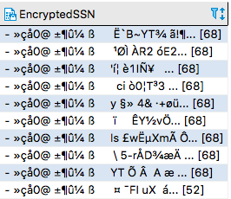
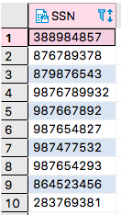
Data Implementation – Data Encryption
Create master key
Protect key information for employees and customers
Encrypted attributes:
Employee ssn - (EmployeeInfo entity)
Customer account password -
(WebsiteCustomerAccount entity)
Create symmetric key to encrypt data
Open Symmetric key
Encrypted select attributes(employee SSN and customer password) during insertion
Decrypt by Key if needed

Slide 8
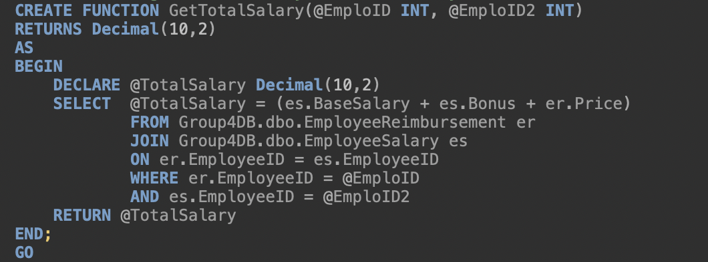
Data Implementation – Computed Column
User-Defined Function
Total Salary = BaseSalary + Bonus + Price
BaseSalary and Bonus from EmployeeSalary
Price from EmployeeReimbursement
EmployeeID used as the reference
Update Function to Insert Data

Slide 9
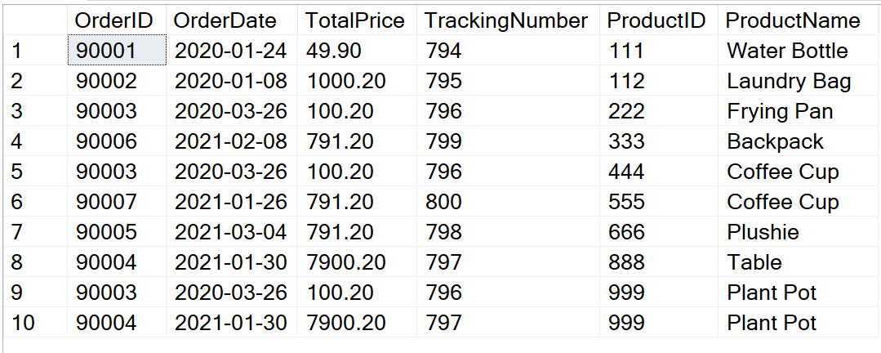
Data implementation-View
CREATE VIEW vwOrderDetail AS SELECT co.OrderID,co.OrderDate,co.TotalPrice,co.TrackingNumber,temp.ProductID,temp.[ProductName ]
From dbo.CustomerOrder co
Join
(SELECT od.OrderID,od.OrderDetailID,wp.ProductID,wp.[ProductName ]
From dbo.[OrderDetail ] od
Join dbo.WarehouseProduct wp
On od.ProductID=wp.ProductID
) temp
On co.OrderID = temp.OrderID;
GO
View1:
This view shows details of orders

Slide 10
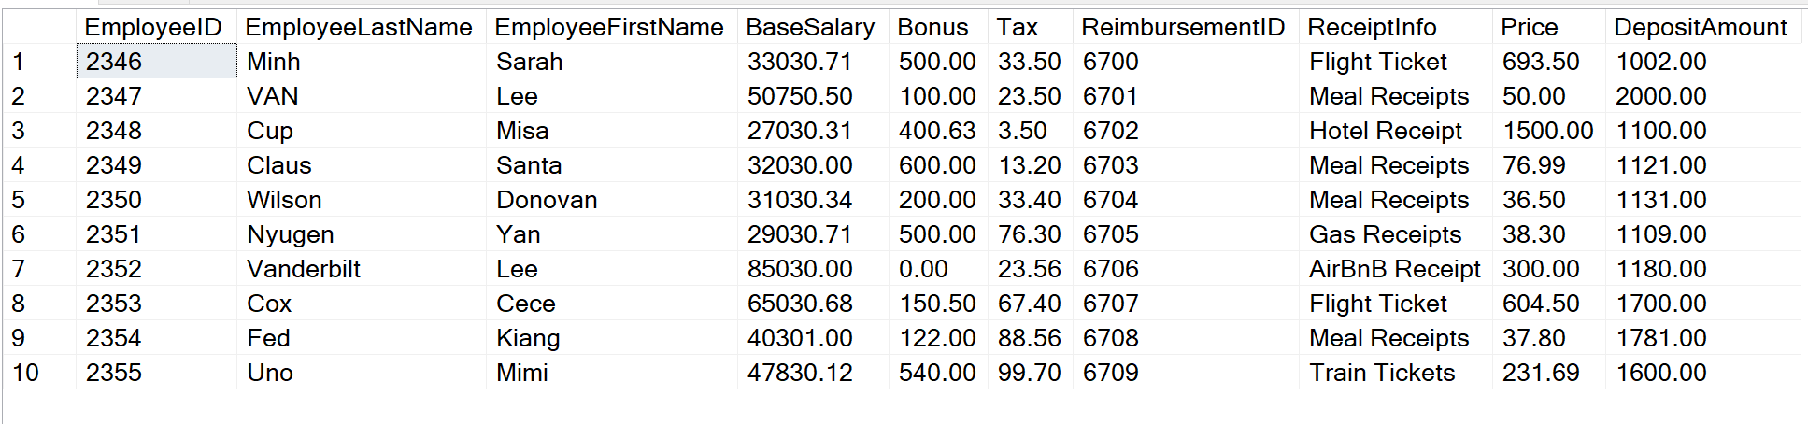
View2: This view show employee salary information
CREATE VIEW vwEmployeeSalaryDetail AS SELECT einfo.EmployeeID,einfo.EmployeeLastName,einfo.EmployeeFirstName,temp.BaseSalary,temp.Bonus,
temp.Tax,temp1.ReimbursementID,temp1.ReceiptInfo,temp1.Price,temp2.DepositAmount
From dbo.EmployeeInfo einfo
JOIN
(Select esalary.EmployeeID,esalary.EmployeeSalaryID, er.RevenueID,er.TotalRevenue,er.Tax,esalary.BaseSalary,esalary.Bonus,esalary.TotalSalary
From dbo.EmployeeSalary esalary
JOIN dbo.Revenue er
ON er.EmployeeSalaryID=esalary.EmployeeSalaryID
)temp
ON temp.EmployeeID=einfo.EmployeeID
JOIN
(Select *
FROM dbo.EmployeeReimbursement ereimbusrsement)temp1
ON temp1.EmployeeID=einfo.EmployeeID
JOIN
(SELECT *
FROM dbo.EmployeeDirectDeposit edd)temp2
ON temp2.EmployeeID=einfo.EmployeeID
GO

Slide 11
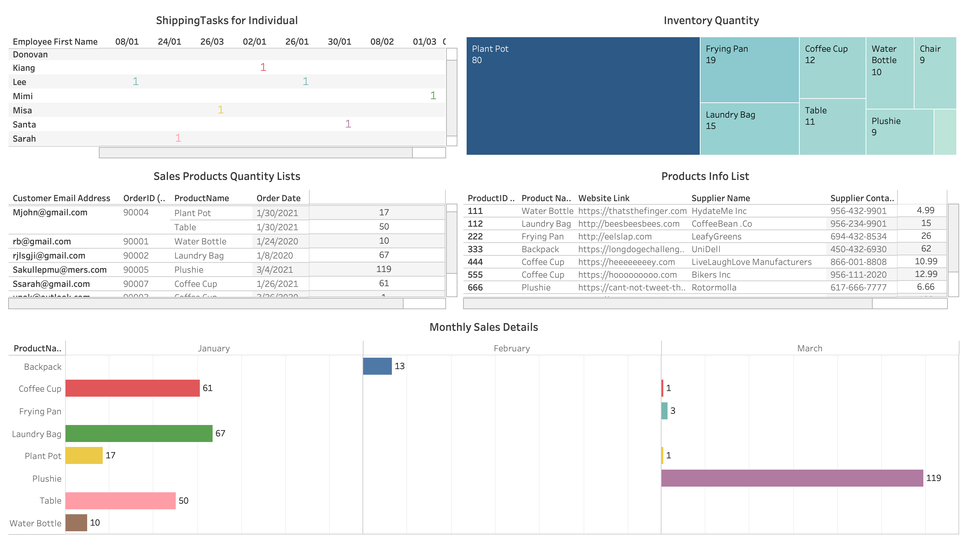
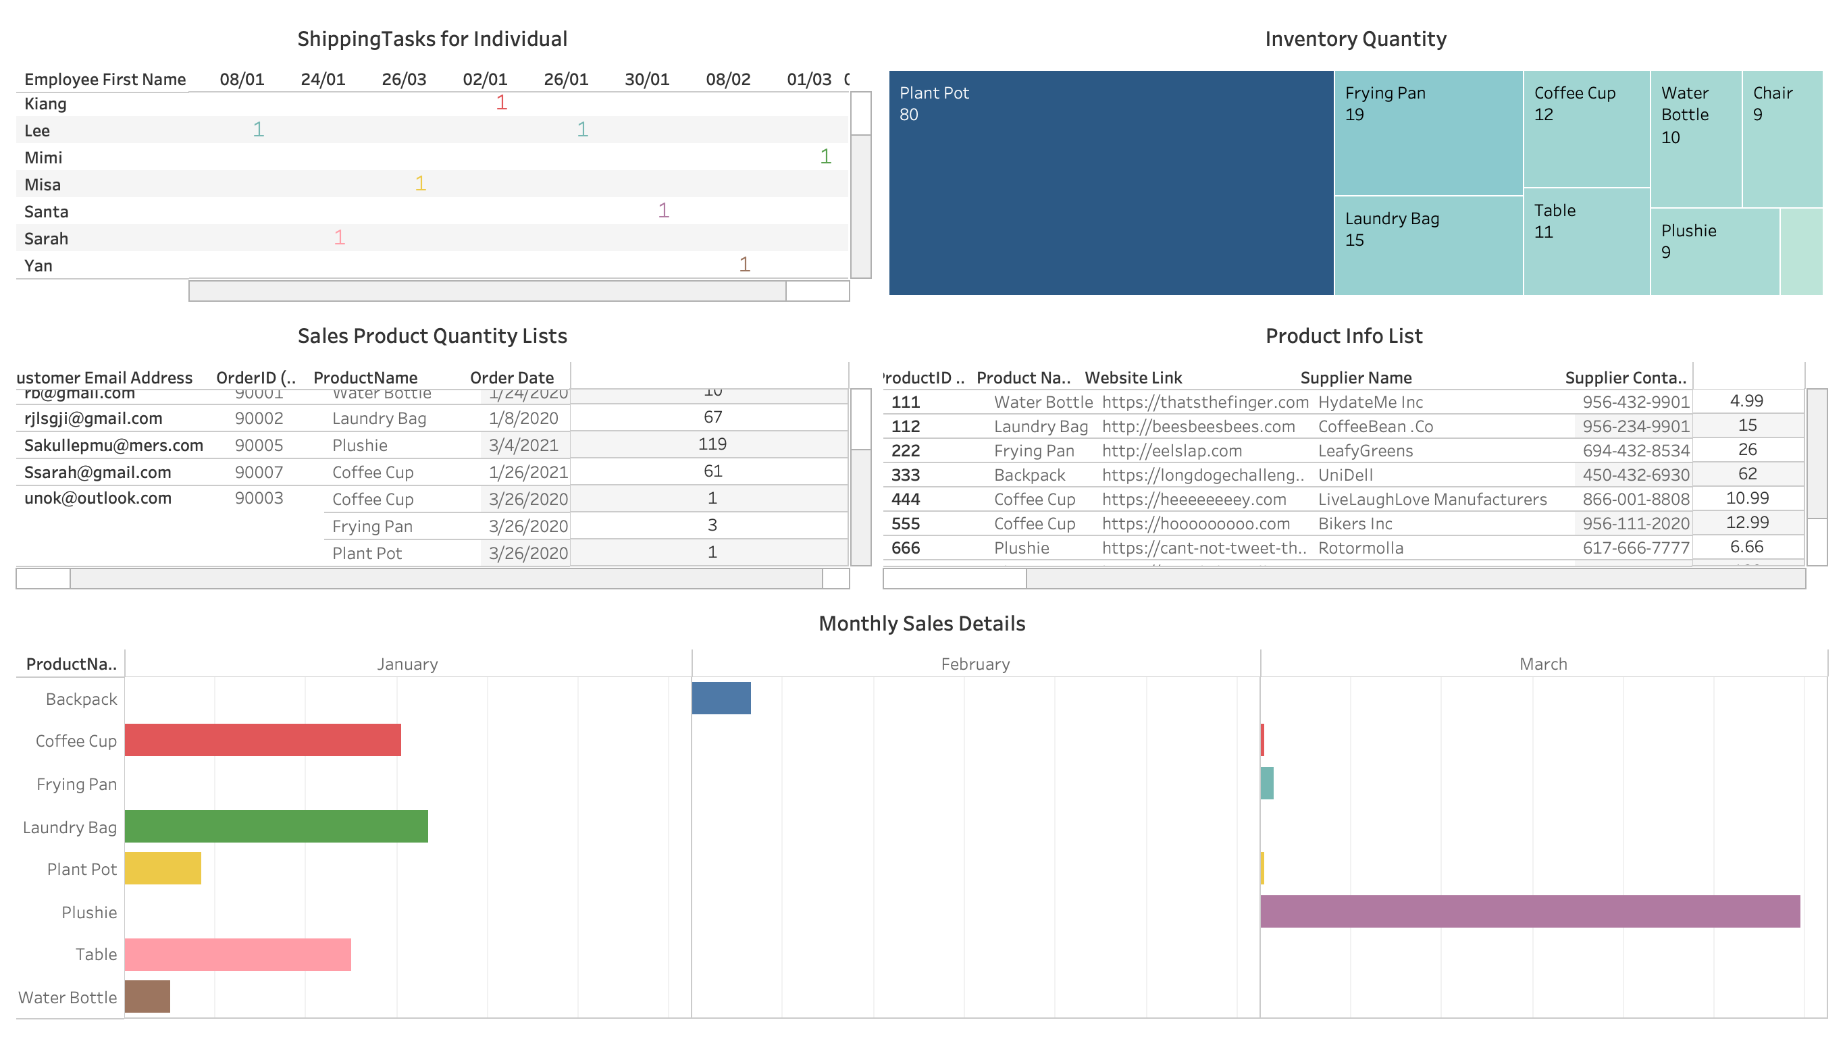
Data Report using Tableau

Slide 12
Thank you! Questions?

